Slide 1
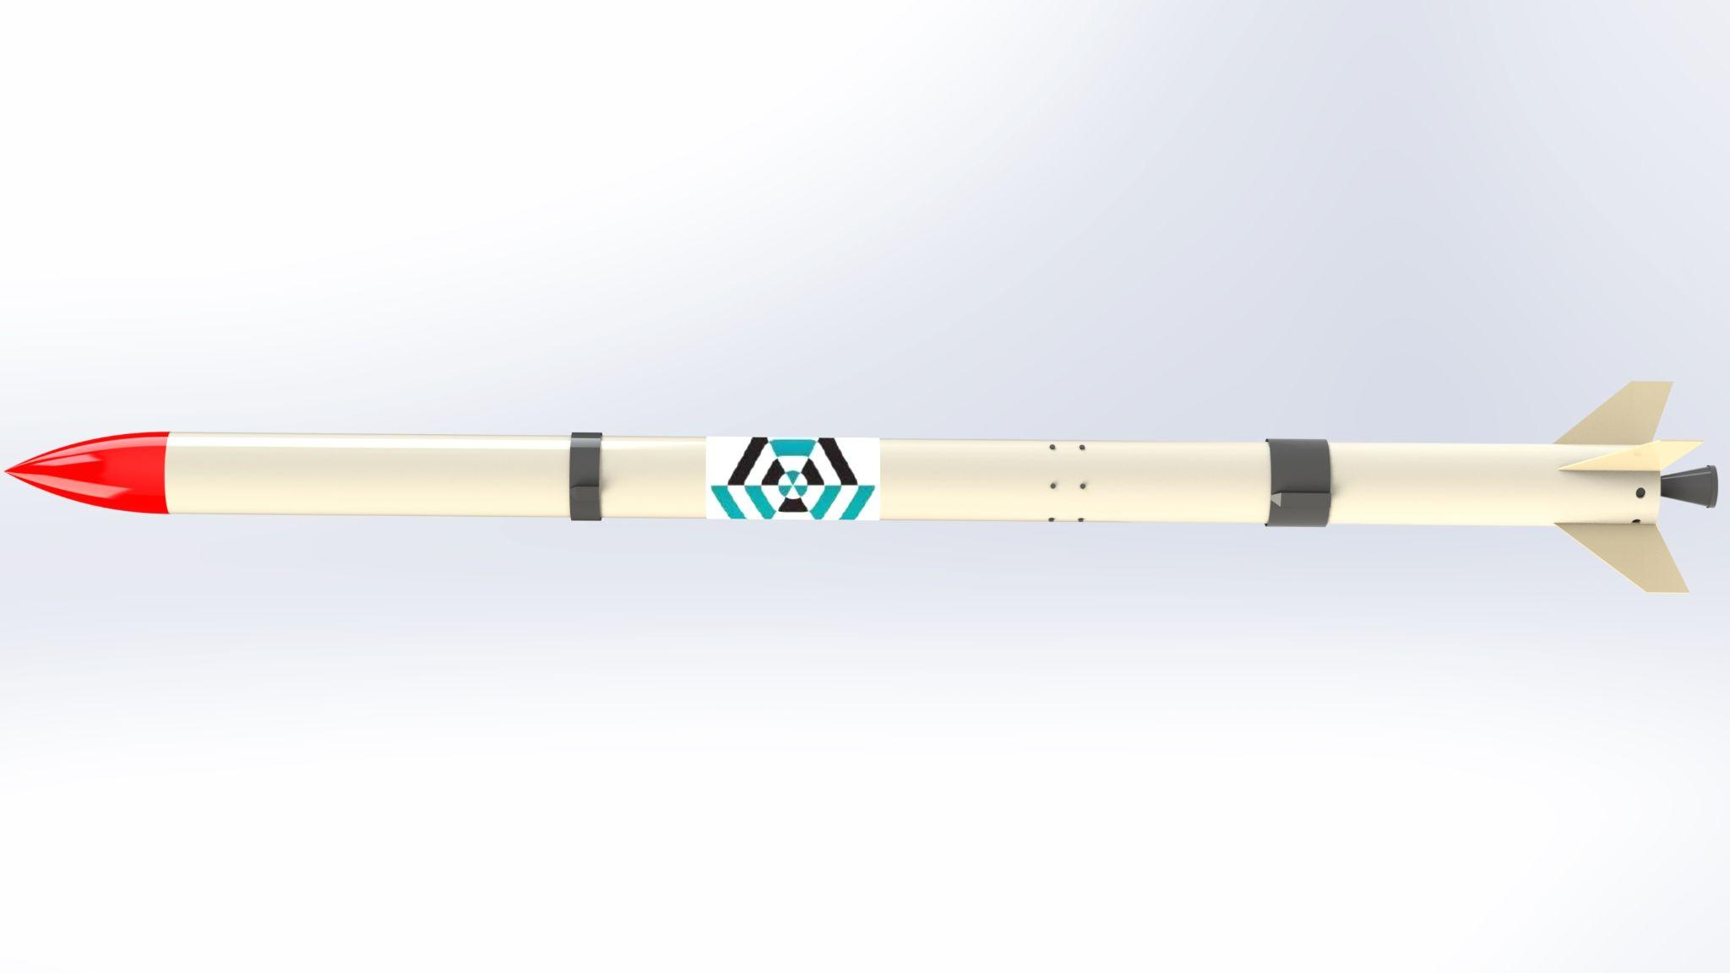
Airframe Progress Report
-15/3/2023-
no_reply@example.com

Slide 2
OVERVIEW
Fabrication of fibreglass #20
Calculation of density of the fabricated airframe

Slide 3
Fabrication of the airframe
#20

Slide 4
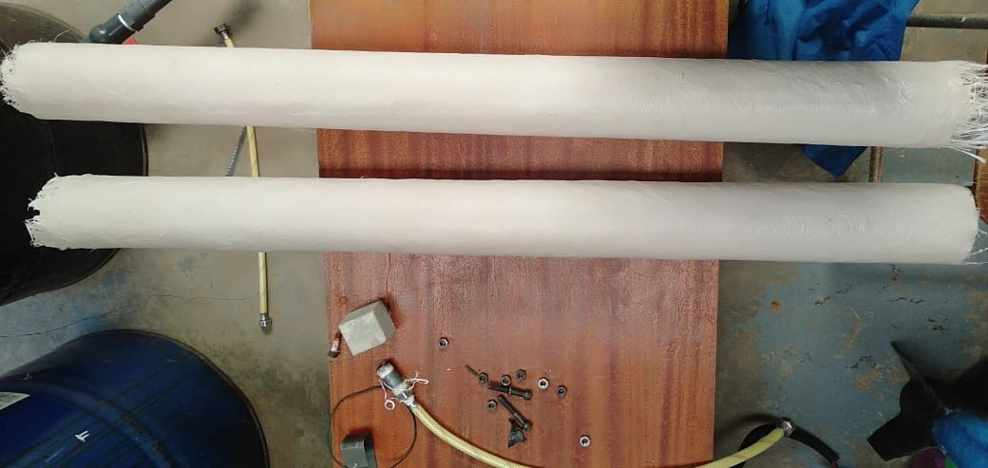
Height: 105cm
Internal Diameter = 8.1cm
Thickness = 0.3mm
Density = 1.479g/cm³
The thickness slightly changed bearing to the fact we used the fibremat, and nylon.

Slide 5
Calculations of density
FABRICATED AIRFRAME 1:
#20
HEIGHT : 105 cm
THICKNESS: 0.3cm
MASS: 1326 g
AVG CIRCUMFERENCE: 29.4 cm
Volume = π *(R² -r²)* h
Volume = 896.38cm³
Density = mass / volume
Volume = 1.479g/cm³
Actual GFRP density lies between
1.25 - 2.5 g/cm³

Slide 6
#20
OPENROCKET SIMULATION:
From the open rocket simulation shown in the next slide, with the fabricated density, we get our component mass as 1053g
HEIGHT : 91 cm
THICKNESS: 0.3cm
DENSITY: 1.479g/cm³
Performing a correlation calculation to get the estimate mass and compare what we have in openrocket:
From the correlation calculation, the mass is 1149.2g
Which is a 9% discrepancy from the simulation.
105cm = 1326g
91cm= ?

Slide 7
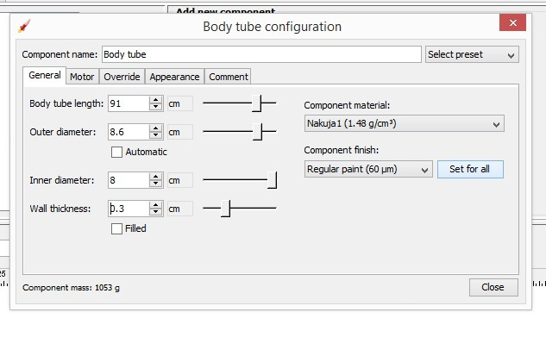

Slide 8
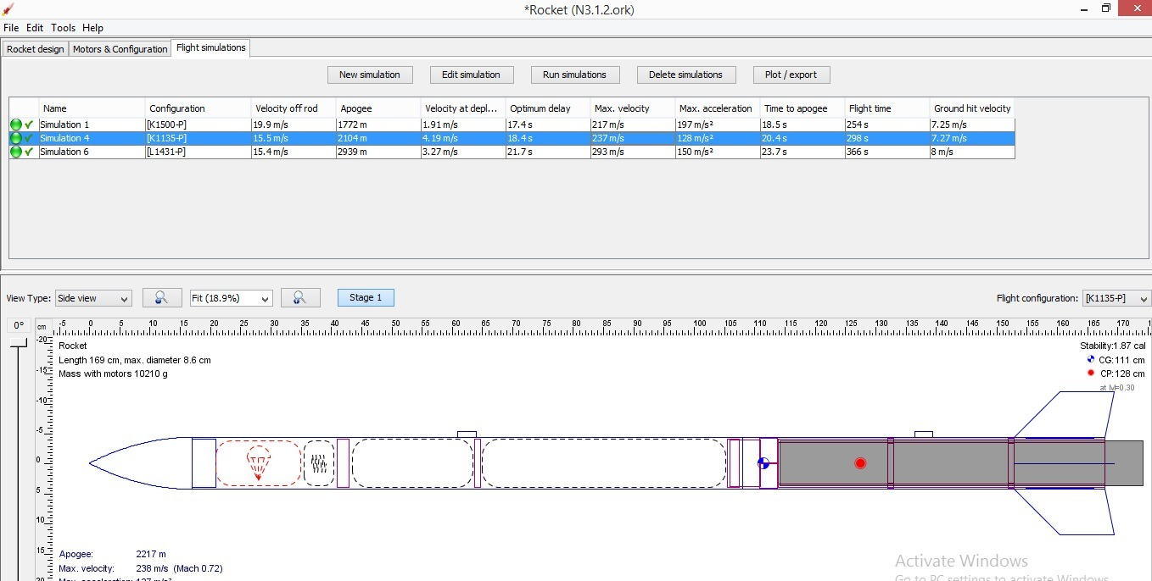
Apogee = 2104m Total mass = 10kg Stability= 1.87 cal

Slide 9
NEXT WEEK’S OBJECTIVES
Fabrication of Aluminum #20
Fabrication of the fin alignment jig

Slide 10
THANKYOU
Q/A

